Slide 1

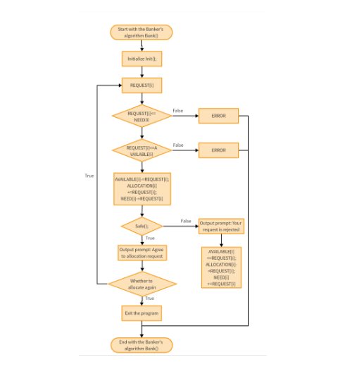
BHUTAN COMPUTER SCIENCE SERIES
Standard Algorithms
Fundamental step-by-step programming methods used to process, search, and manage data efficiently in Python and modern computing.

Slide 2



Definition
What is a Standard Algorithm?
Bhutanese Application Context
A standard algorithm is a reliable, step-by-step method used repeatedly to solve fundamental computing problems.
Sorting national student examination scores
Searching citizen directory and service records
Calculating seasonal agricultural and weather data

Slide 3






Key Benefits
Why Are Standard Algorithms Useful?
Tested & Proven
Highly Reusable
Reliable logic guaranteed to work across all Python applications.
Reuse the same code pattern across educational and software systems.
Easier Debugging
Logical Thinking
Makes finding and fixing errors simple for student programmers.
Develops structured, step-by-step problem-solving skills.

